Slide 1
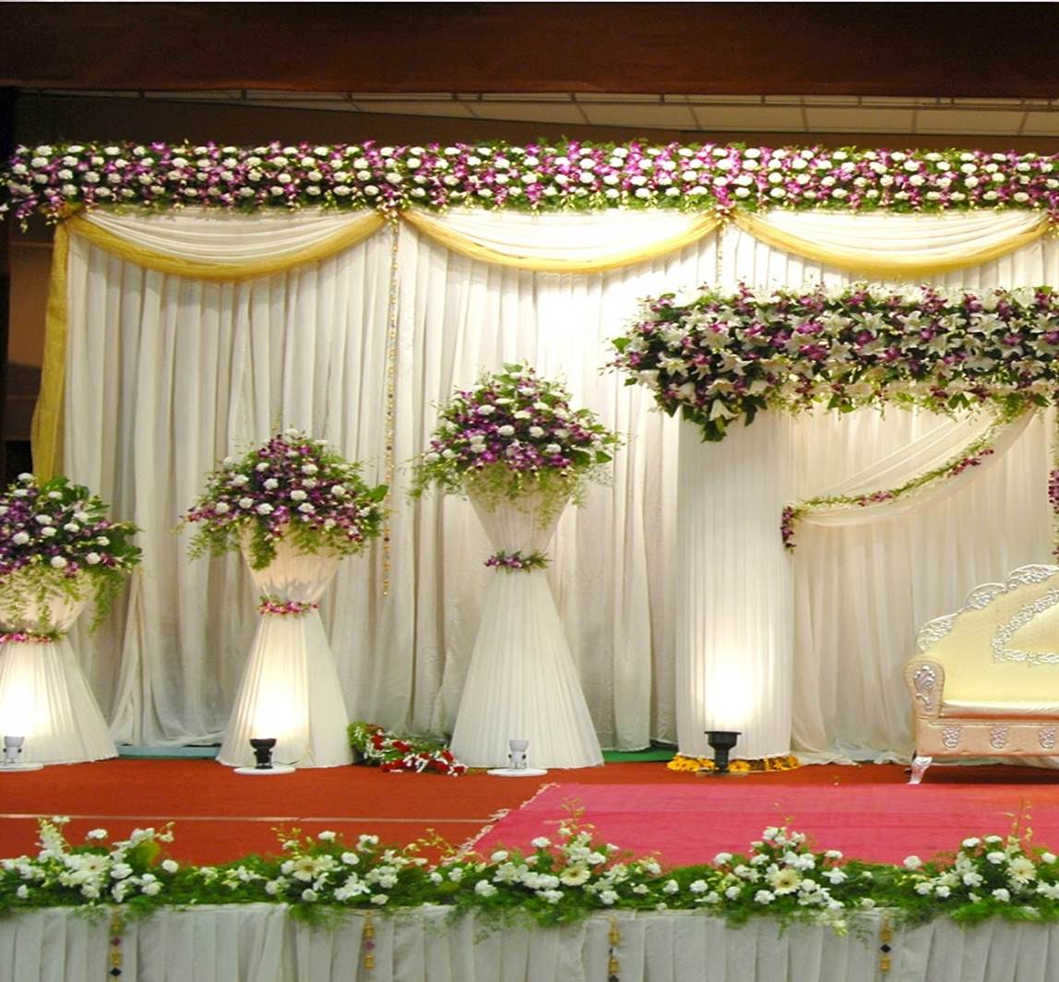
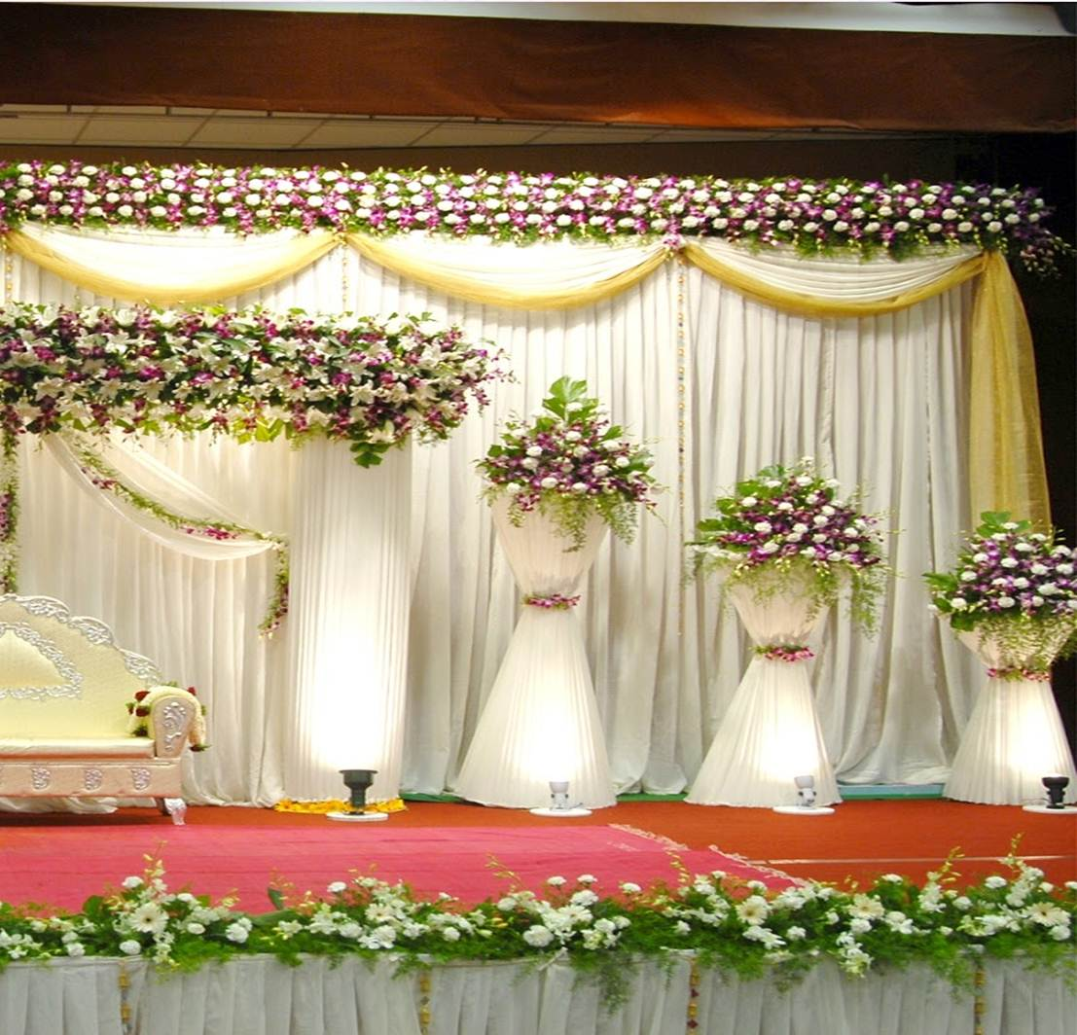
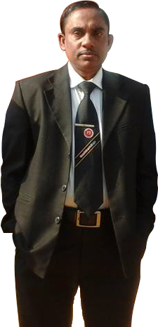
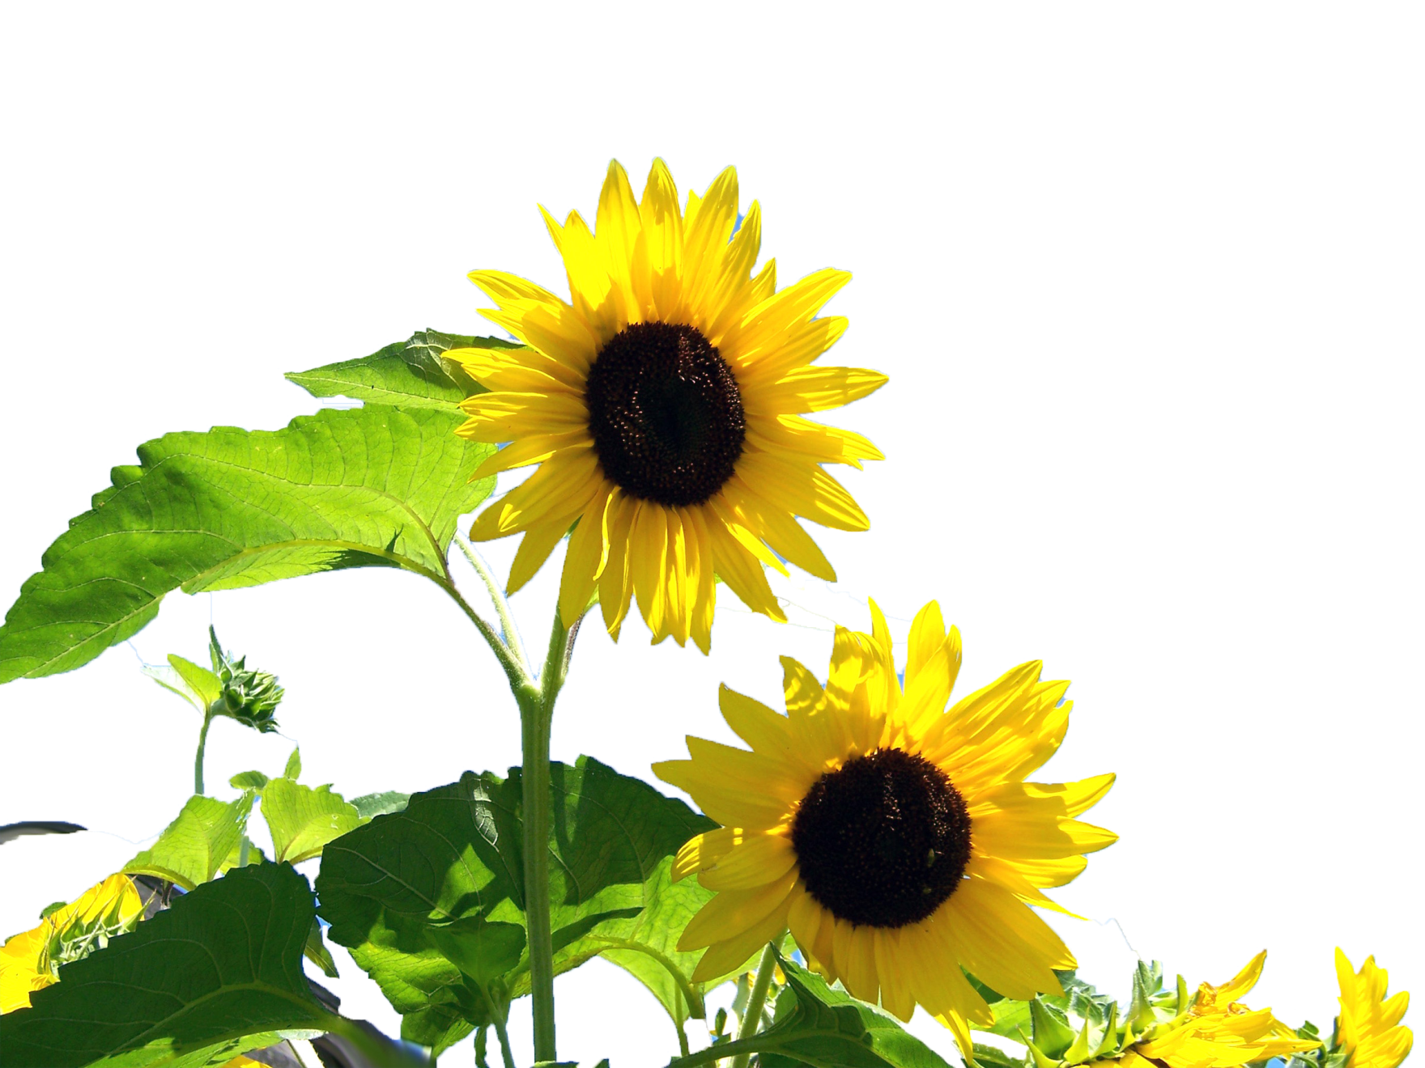
Welcome to the World of HHR English Multimedia Presentation
Md. Hasan Hafizur Rahman
Lecturer & Head of the Department (English)
Cambrian School & College
Dhaka
Presentation made for class
VI-X
English 2nd paper
Composition Part
Notes:
Welcome and identity of the content builder and class with subject in one slide.

Slide 2
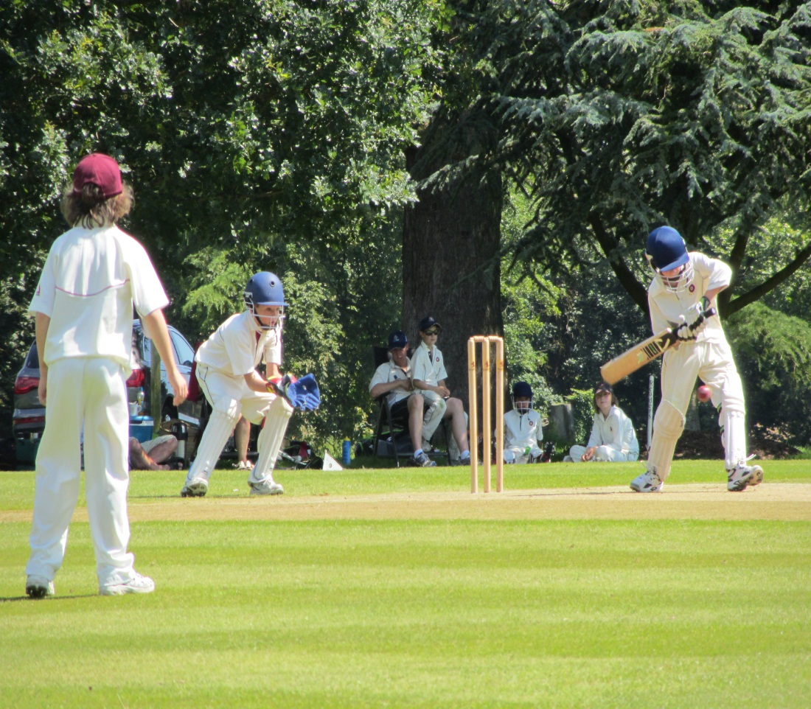
Gardening
Swimming
Reading
Playing
Profession?
Hobby?
What do you mean by the pictures?
Notes:
Suspension to lead the lesson.

Slide 3
Our today’s lesson is -
Your Hobby
It is a composition.
Notes:
Lesson declaration.

Slide 4
Learning outcomes
At the end of the lesson we will be able to-
define hobby
differentiate hobby
describe self hobby
write a composition
Notes:
The main aim of this lesson is to make the students able writing a composition on hobby.

Slide 5
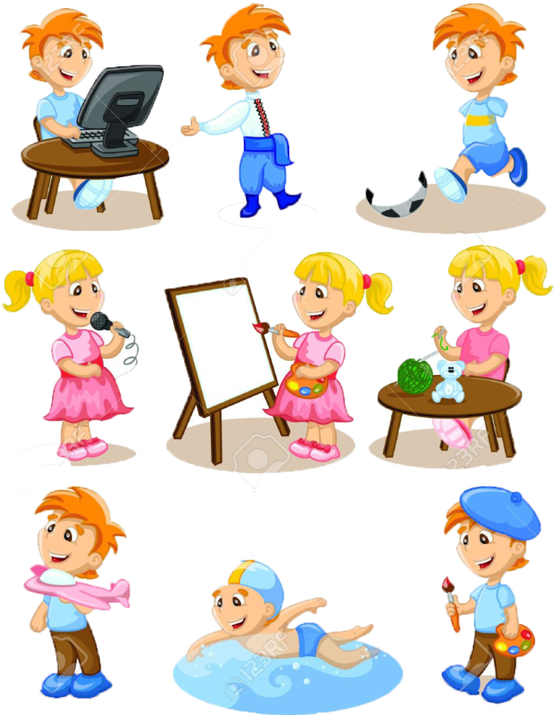
Many persons many minds, many choices, so hobby varies from person to person. It is his occupation but not main business.
Almost every person has his own hobby. He enjoys his leisure culturing hobby. It may not bring him money but it gives him much pleasures. Sometimes it may be the source of income.
Man cannot live without enjoyment. Hobby is the main way to enjoy life. It helps keeping mind in a sound body. So it is essential to everybody.
Notes:
Learning outcomes No 1 & 2 will be effective from this slide.

Slide 6
I am a student. I have a hobby. It is gardening.
Notes:
Personal information of hobby.

Slide 7
My garden is in front of my reading room. I have planted different kinds of flowers and vegetables here. I have chosen gardening as my hobby because I find much interest in it. I think it is helpful for my body, mind and soul.
Notes:
Situation and cause of choice of this occupation.

Slide 8
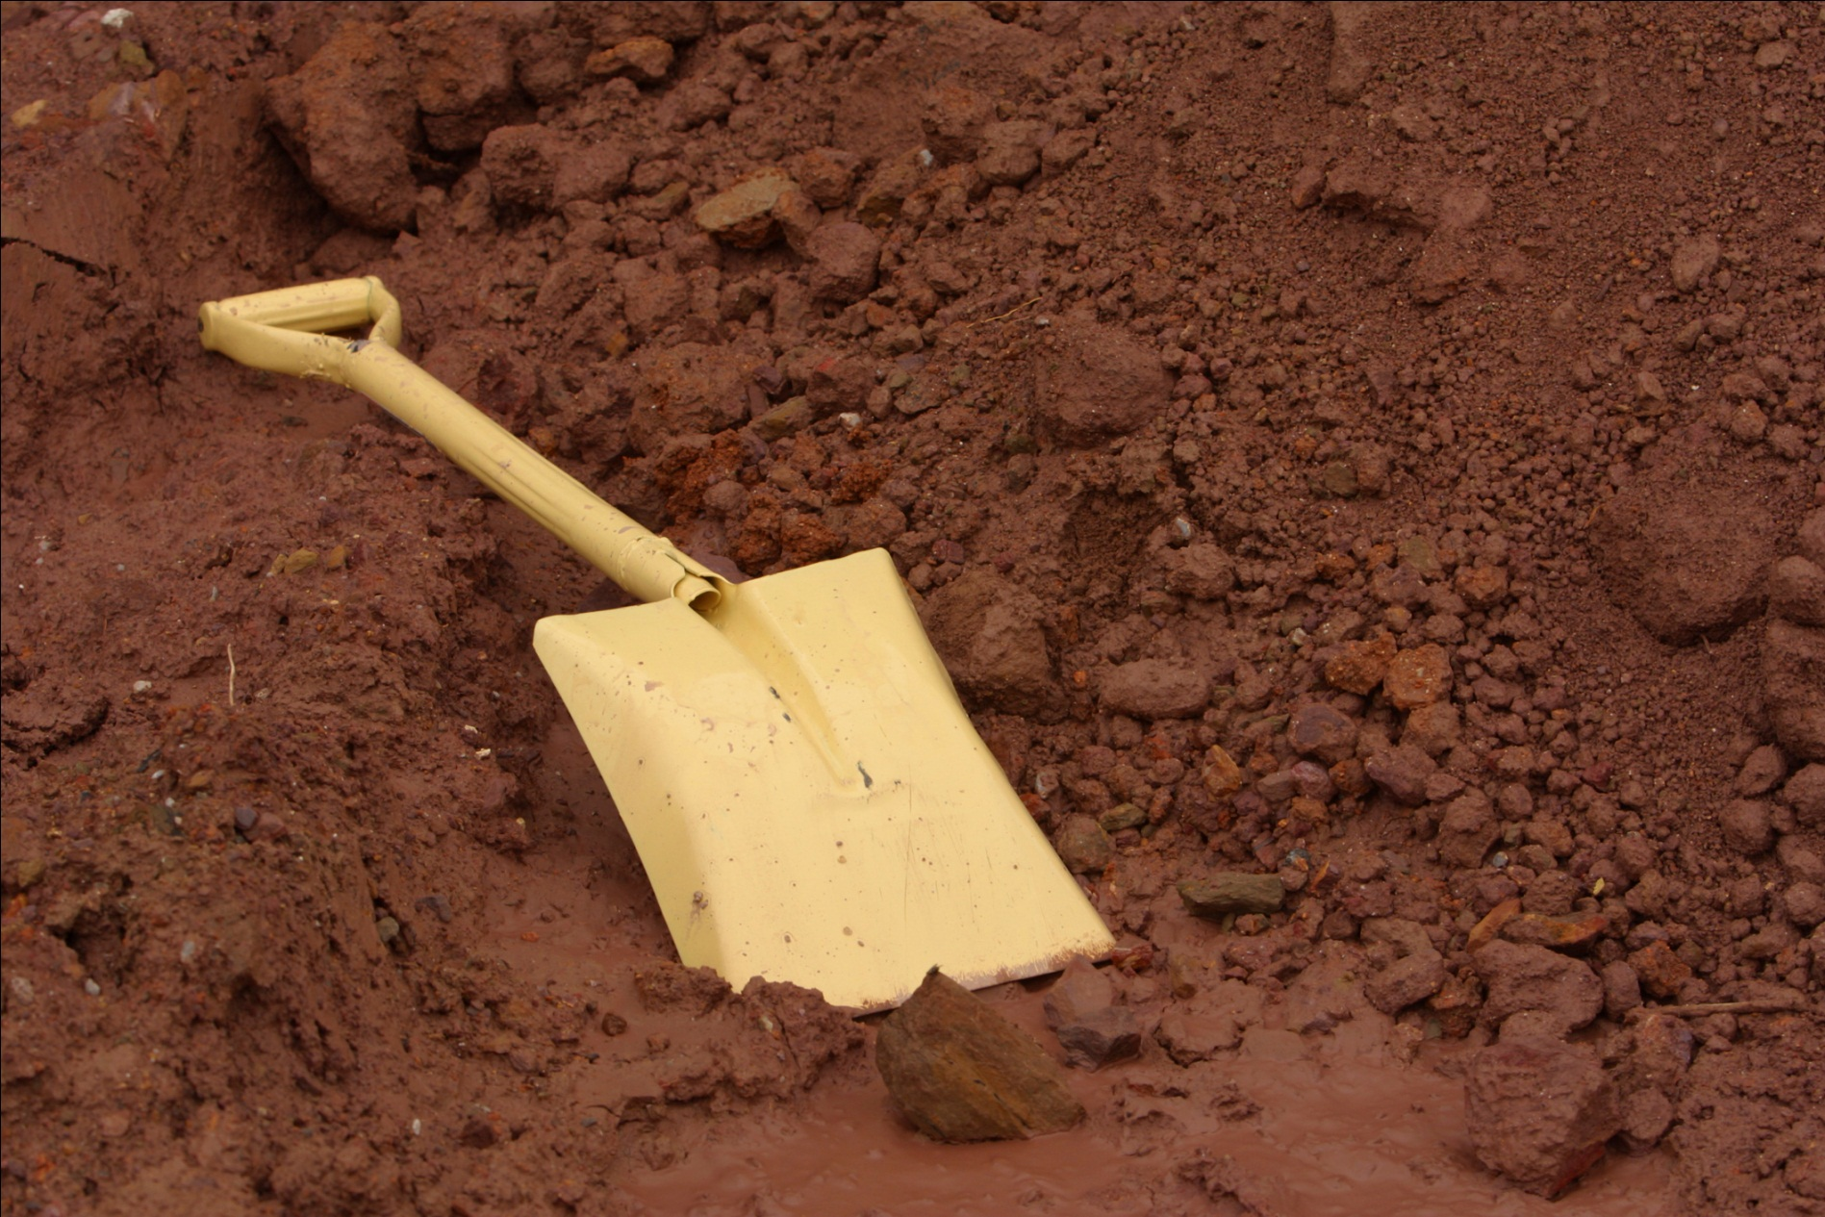
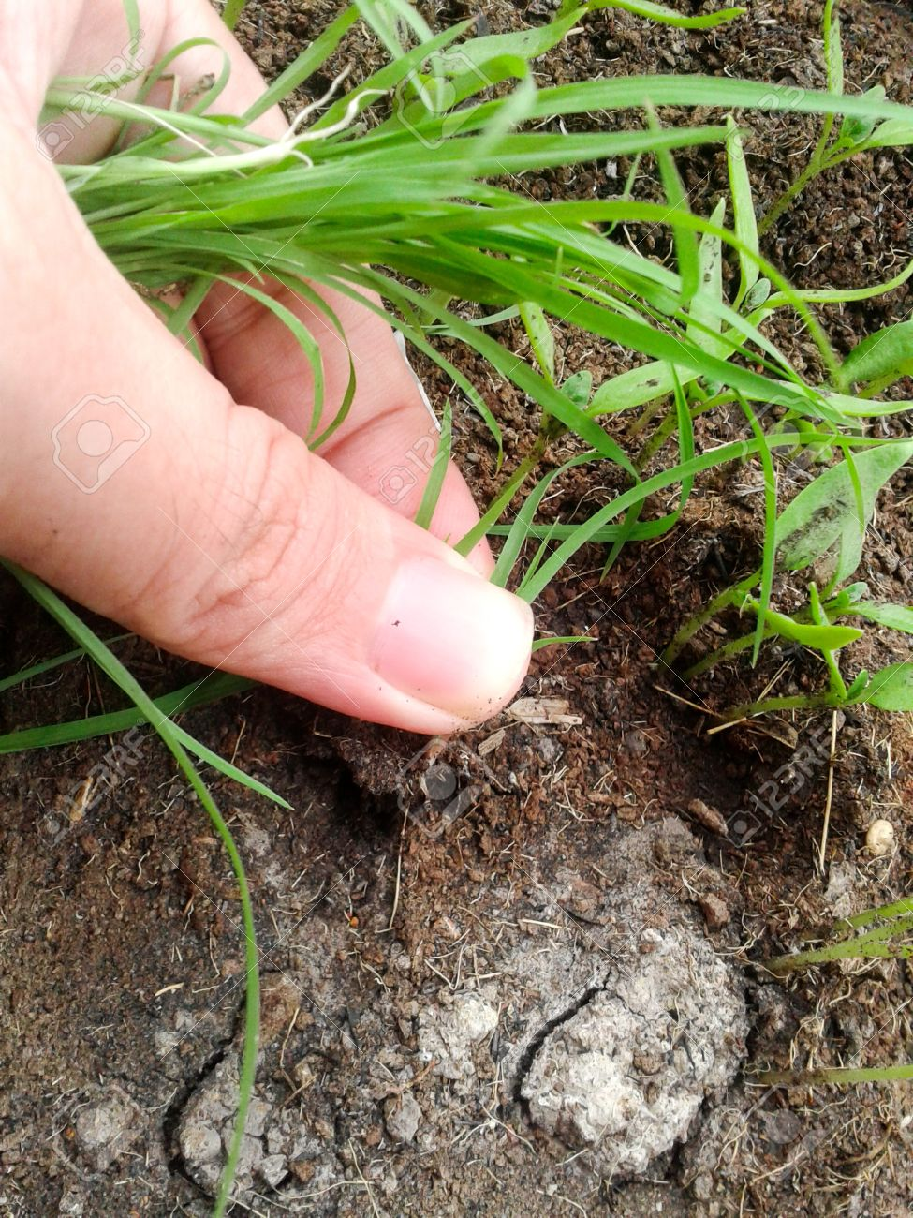
Whenever I get time, I work in it. I loose the soil with spade and weed out the grasses.
Notes:
Activities in the garden.

Slide 9
I water the plants regularly.
Notes:
Regular job.

Slide 10
I have put a fence around my garden so that naughty boys and cattle cannot do any harm to it.
Notes:
Protection measures.

Slide 11
My joys know no bounds when I enter into my garden and see the flowers blooming. The butterflies and other little birds add a beautiful view in my garden. I also enjoy the chirping of birds in the morning.
Notes:
Attraction of garden.

Slide 12
When the flowers spread the sweet and soft scent around my reading room, I enjoy it and I can concentrate my mind to study. At night when I sleep, the windows remain open and the wonderful sweet scent blows over my nose. I can enjoy heavenly sleep for my garden.
Notes:
Heavenly enjoyment.

Slide 13
My garden plays an important role to build up my health. Before making the garden I could not do any work properly, I lost my taste of food. I did not feel hungry, I could not take a sound sleep. Day by day I became weak but now all my problems are recovered.
Notes:
It is helpful for health.

Slide 14
Everyday at least an hour I work in my garden. As a result, it helps to circulate my blood well. The beauty and sweet smell of different flowers make me jolly. On holidays I work more in my garden. When my friends come to my home, I take them into my garden and show them various flowers. They become very glad to see my garden and thank me.
Notes:
How I pass my time in the garden.

Slide 15
In one corner of my garden I grow some vegetables. It grows very well in my garden. We don’t need to buy vegetable from the market. It is fresh and formalin free. My mother becomes very pleased when I give her fresh vegetables. She makes delicious dishes with the fresh food for our family. We enjoy it everyday.
Notes:
Another portion of garden.

Slide 16
Thus my hobby is a great source of joy and pleasure. It relieves me from routine bound work. It helps me forget sorrows and sufferings. It makes my body and my mind jolly.
Notes:
Feelings.

Slide 17
Evaluation
Answer the following questions
What is a hobby?
What is your favourite hobby?
Why is gardening your hobby?
What plants have you grown in your garden?
How do you nurse your garden?
What another item do you cultivate in your garden?
What is your feeling about your hobby?

Slide 18
B
Y
E
Notes:
Ending slide.

Slide 19
Acknowledgement
We would like to express our cordial gratitude to the Ministry of Education, Directorate of Secondary & Higher Education, NCTB, A2i and the panel of honorable editors (Md. Jahangir Hasan, Assistant Professor (English) TTC, Rangpur, Ranjit Poddar, Associate Professor (English) TTC, Dhaka, and Urmila Khaled, Assistant Professor (English) TTC, Dhaka, to enrich the contents.

